Slide 1
TSFM GENE MUTATION

Slide 2
AGENDA
Definition;
  tsfm gene and TSFM gene mutation
Biochemistry
  Oxidative phosphorylation
  Lactic acidosis
  Citric acid cycle
conclusion

Slide 3
definition
Tsfm gene
  This is a protein coding gene responsible for encoding a mitochondrial translation elongation factor.
TSFM GENE MUTATION.
  Action by the TSFM gene that is associated with a combined oxidative phosphorylation deficiency.
  In cases of alternative splicing leads to multiple transcript variants.
Notes:
The encoded protein is basically an enzyme acting as a catalyst in the exchange of guanine nucleotides on the translation elongation factor Tu (Perli et al 5108).
This occurs during elongation step of mitochondrial protein translation.
Another disease associated with TSFM is the combined oxidative phosphorylation deficiency 3.

Slide 4
biochemistry
      Oxidative phosphorylation

Slide 5
Oxidative phosphorylation
This is a termination of a sequence of energy transformation. it can be referred to as respiration or simple respiration in their entirety.
It is considered to be a metabolic pathway by which there is oxidation of nutrients by cells which use enzymes for the oxidation process.
During oxidative phosphorylation, there is the transfer of electrons donors to electron acceptors. For example oxygen in redox reaction that release the energy that is stored in some relatively weak double bonds of oxygen. This is used in the formation of ATP.
Notes:
In eukaryotes, the redox reactions are usually catalyzed by a sequence of protein complexes.
The protein complexes are within the inner membrane of cell’s mitochondria.
In the prokaryotes, the proteins are within the cell’s intermembrane space (Weber et al 58).
When these sets of proteins are linked together, they form the electron transport chains used to transport protons across the inner mitochondrial membrane.
The oxidative phosphorylation is known to be a crucial metabolism that produces reactive oxygen species for example, hydrogen peroxide and superoxide. These are responsible for propagation of free radicals which damage cells, cause diseases and possible chances of aging(Weber et al 58).

Slide 6
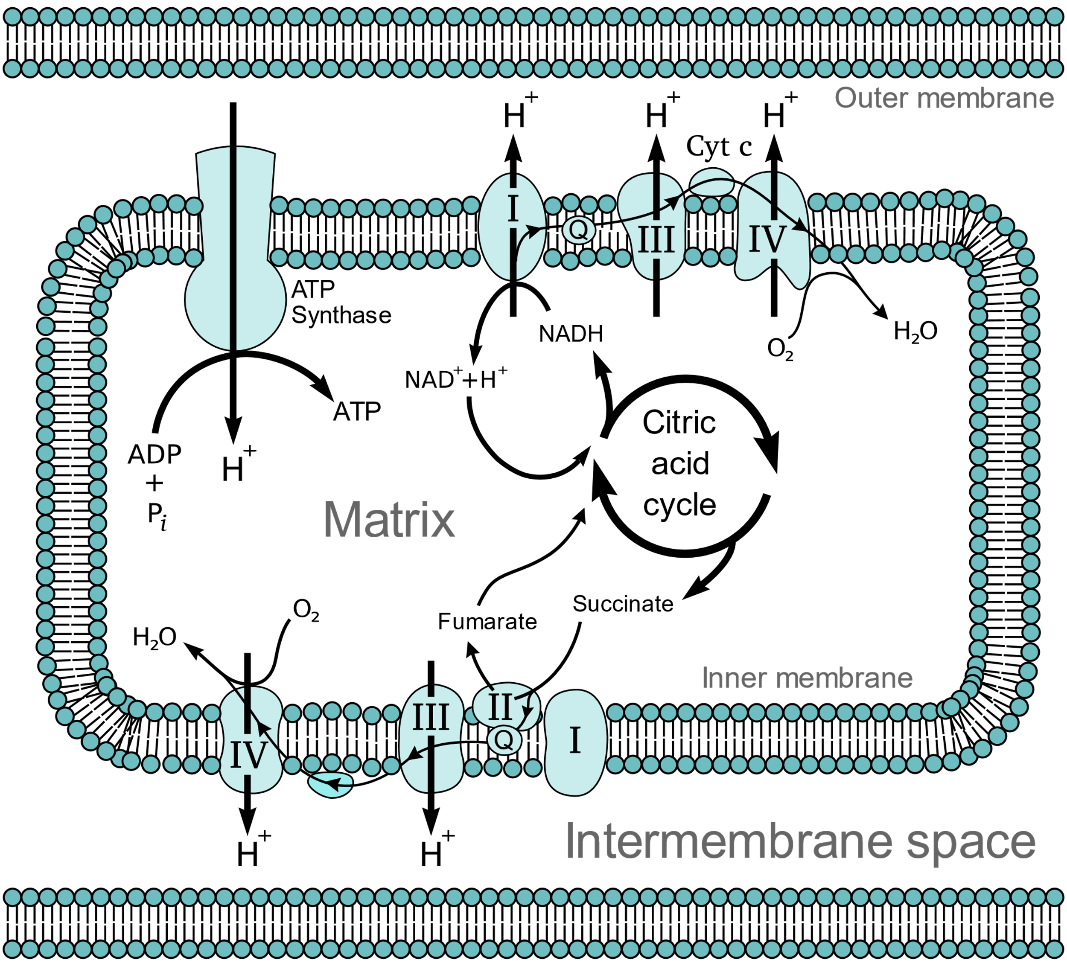
ELECTRON TRANSPORT CHAIN
Notes:
Glycolysis, beta oxidation, and citric acid cycle help in the production of cofactor NADH.
This is a coenzyme that is comprised of electrons with high transfer potential. The NADH removes electrons which are passed to oxygen. Then, they are passed through a sequence of enzymes. Each of these enzymes release small amounts of energy (Weber et al 58).
The set of enzymes basically have complexes I through IV. It is then referred to as electron transport chain.
In eukaryotes, the enzymes found in the electron transport system use the energy that is released from oxygen by NADH. It pumps the protons past the inner membrane of the mitochondrion.
This process lead to building of protons in the intermembrane space. There is generation of an electrochemical gradient past the membrane.
The energy that is stored in this potential is usually used by ATP synthase and helps in the production of ATP.

Slide 7
Combined oxidative phosphorylation deficiency
This is known as infantile hypertrophic cardiomyopathy.
It is characterized by a reduced level of mitochondrial complexes.
The signs and symptoms characterized with this condition comprise of an enlarged heart muscle, eye problems, head ache, fatty liver and paralysis of one side of the body.
The combined oxidative phosphorylation deficiency is caused by the GFM1 gene mutation which is basically leads to mitochondrial dysfunction.
Such cases can be inherited in a autosomal recessive pattern.
Notes:
The GFM1 gene gives instructions for the production of enzyme referred to as mitochondrial translation elongation factor G1. The enzyme is located in cell structures mitochondria.
The mitochondrial translation elongation factor G1 responsible for the release of proteins from mtDNA genes in a process known as translation. The role of the enzyme in translation is to ensure there is a good coordination in the movement of mtRNA molecules (Perli et al 5108).
The genes on the mtDNA gives instructions to proteins which are involved in converting energy from food into form that cells can use also referred to as oxidative phosphorylation.
GFM1 gene mutation leads to a reduction of mitochondrial translation elongation factor G1 function and few mitochondrial proteins are produced during the oxidative phosphorylation process leading to a combined oxidative phosphorylation deficiency which affects organs with high energy demand like the heart, brain and liver(Weber et al 58).
With a shortage in energy supply in tissues of these organs, it results to death of cells leading to problems like liver failure, and neurological problems.

Slide 8
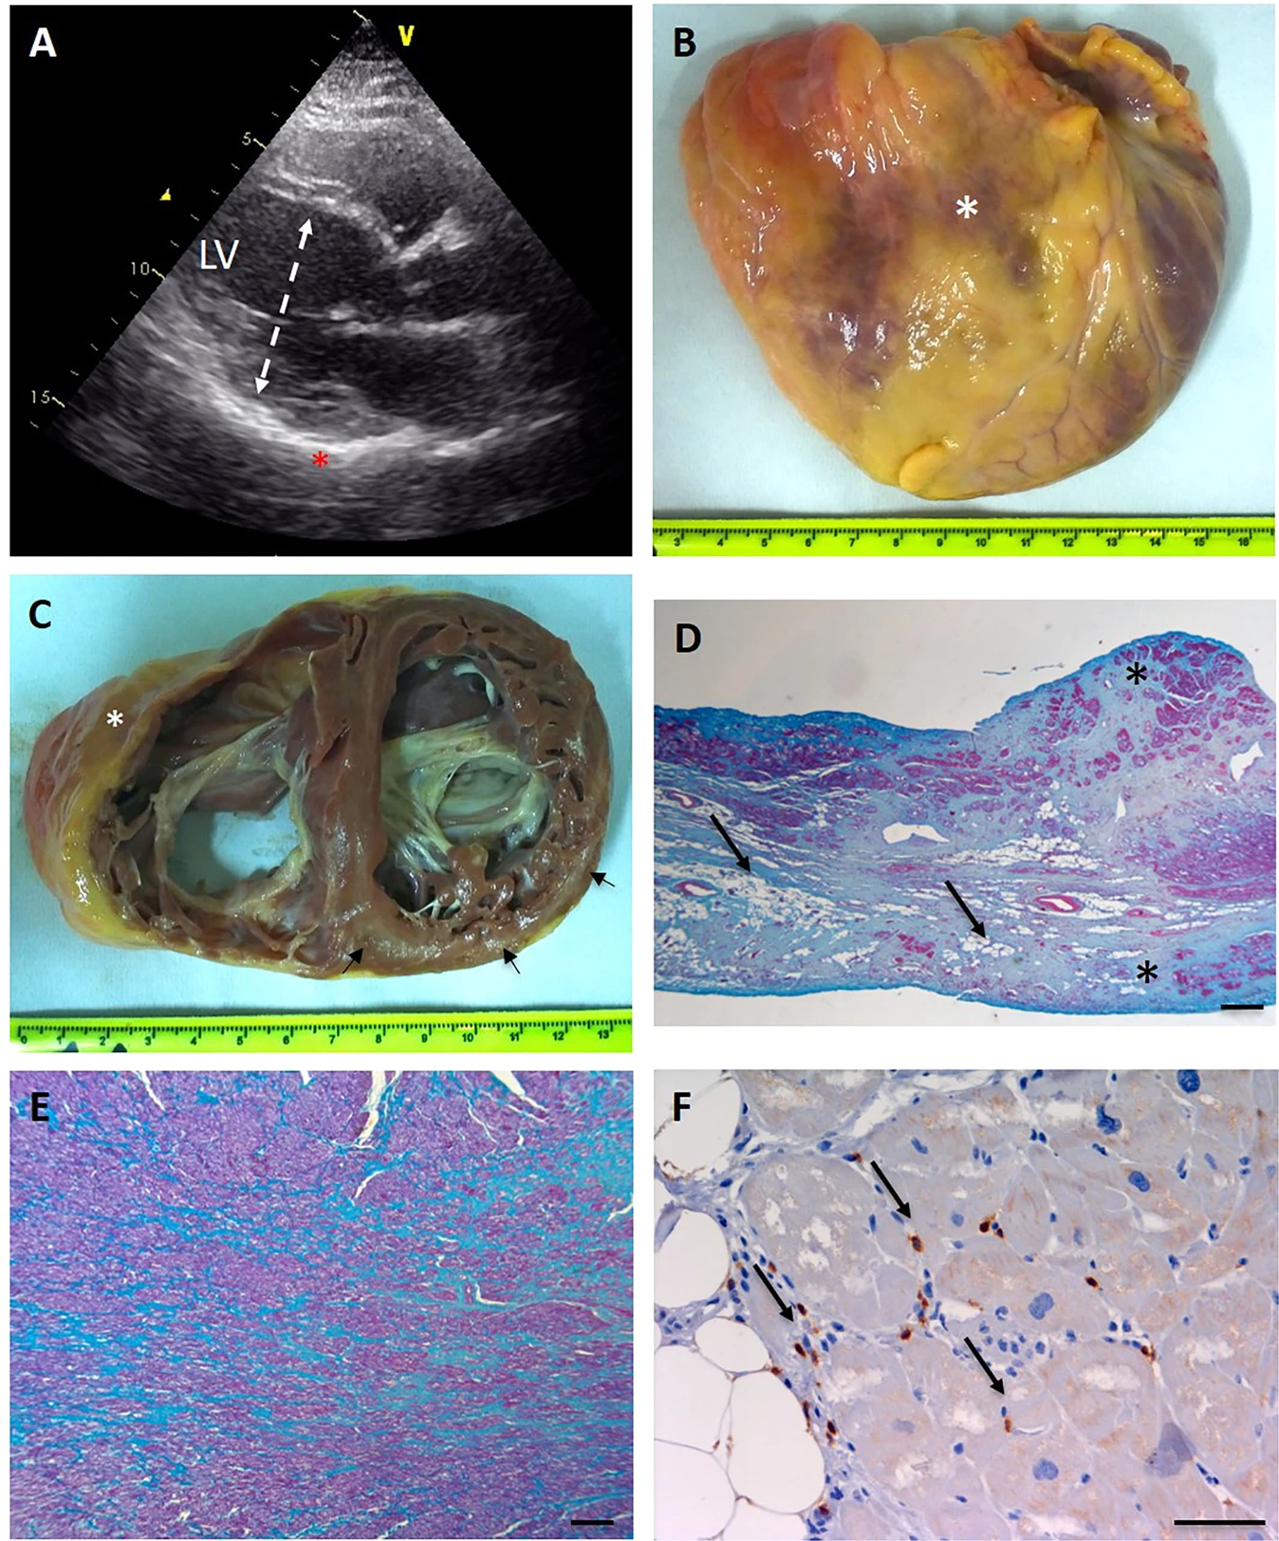
Enlargement of the heart due to Combined oxidative phosphorylation deficiency
Notes:
Focusing on the enlargement of the heart from picture A, B and C
An echocardiographic long axis view during a diagnosis period. There is an increased wall ecoreflexibility.
This represents a view of an enlarged heart. It is seen to have a transverse diameter of about 120mm.
This is a cross section of the heart that shows biventricular enlargement. Right ventricle chamber has a diameter of 50mm and left ventricle chamber has a diameter of 55mm.

Slide 9
BIOCHEMISTRY
              LACTIC acidosis

Slide 10
Lactic acidosis
This is a type of metabolic acidosis associated with overproduction or underutilization of lactic acid.
In this case, the body is unable to adjust such changes.
People suffering from such a condition are known to experience liver problems and sometimes with their kidneys as they are unable to eliminate excess acid from their bodies.
Notes:
When the acid builds-up, there is an imbalance in the pH level in the body. The body’s pH level needs to remain slightly alkaline. The acid increases when the muscles lacks enough oxygen necessary to break down glucose and glycogen (Vemuri et al 2403).
There are two types of lactic acidosis namely;
Type A lactic acidosis that is caused by tissue hypoperfusion. It leads to hypovolemia, sepsis, cardiopulmonary arrest and cardiac failure
Type B lactic acidosis usually caused by impairment of cellular functioning. It is also caused by localized sections of tissue hypoperfusion.
However, the effects of lactic acidosis can be treated and if left untreated can be life-threatening.

Slide 11
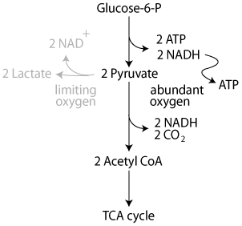
Cori cycle
Notes:
The Cori cycle is known as a metabolic pathway in which anaerobic glycolysis in the muscles produces lactate that is transported to the liver after which it is changed into glucose. The glucose is returned to body muscles and cyclically metabolized back to lactate (Vemuri et al 2403).
The process requires sufficient supply of oxygen since when there is an intense muscular activities, energy is always released through anaerobic metabolism.
Lactic acid undergoes fermentation which converts pyruvate to lactate through a process known as lactate dehydrogenase. In this process, the fermentation process regenerates NAD+, maintains its concentration and hence glycolysis reactions take place (Vemuri et al 2403).
Through gluconeogenesis, glycolysis and the conversion of lactate into pyruvate, glucose is produced which is supplied to body muscles through bloodstreams.
The entire glycolysis steps lead to production of 2 ATP molecules instead of 6 ATP molecules which are consumed in the gluconeogenesis steps.

Slide 12
Treatment of lactic acidosis
Most lactic acidosis cases are as a result of poor prognosis.
Treatment of lactic acidosis involves use of;
  Sodium bicarbonate
  Peritoneal dialysis and hemodialysis
  Sodium nitroprusside
  Insulin therapy
Notes:
Surveys have shown that many cases related with severe lactic acidosis are caused by poor prognosis. This condition requires correct diagnosis and prognosis procedures to guarantee a successful treatment.
Use of sodium bicarbonate is a therapeutic modality used to treat lactic acidosis. But researches have proven that aggressive use of sodium bicarbonate can lead to serious complications if not used with great caution(More, and Pai 368).
Peritoneal dialysis and hemodialysis is a method that provides large amounts of alkali. The technique does not cause hypernatremia or hypervolemia which is associated with bicarbonate infusion.
Sodium nitroprusside is another method used as it helps to treat some forms of lactic acidosis. It is considered an effective method as it alleviates regional hypoperfusion.
Insulin therapy is an effective treatment that is associated with the treatment of phenformin-associated lactic acidosis.

Slide 13
biochemistry
Citric acid (krebs) cycle

Slide 14
CITRIC ACID (KREBS) CYCLE
This cycle is associated with sequence of reactions that contribute to production of two carbon dioxide molecules; GTP, ATP and NADH molecules and FADH2 molecule.
The citric cycle takes place with the mitochondria.
Almost all enzymes of the krebs cycle are soluble and they have a single exception of the enzyme succinate dehydrogenase.
The succinate dehydrogenase is embedded within the internal membrane of the mitochondrion.
Notes:
The citric cycle is basically a closed loop.
The last section of the pathway usually regenerates the compound that is used in the first step.
The cycles has eight steps; dehydration, hydration, a series of redox, decarboxylation reactions responsible for the production of two carbon dioxide molecules that is GTP/ATP and reduced forms of NADH and FADH2 (More, and Pai 368).
This process is known as an aerobic pathway since the NADH and FADH2 always transfer their electrons to other pathways forming a system that uses oxygen.
When the transfer fails to occur, the oxidation of citric acid automatically fails as well.
It is necessary to note that, the Krebs cycle produces little ATP directly and therefore does not directly use a lot of oxygen (Vemuri et al 2404).

Slide 15
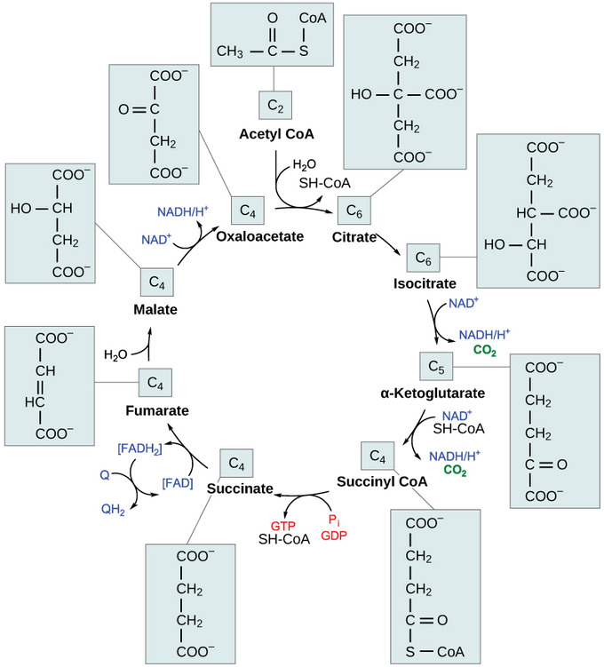
Notes:
The first step is known as the condensation step. In this step, there is a combination of two-carbon acetyl group with four-carbon oxaloacetate molecule. This lead to the formation of six-carbon molecule of citric. CoA is bound to a sulfhydryl group. It is diffused away and combines with another acetyl group. An increased levels of ATP leads to reduced rate of reaction and vice versa (Vemuri et al 2403).
Step 2. There is lose of one water molecule by the citrate which eventually gains another as it changes into its isomer, isocitrate (More, and Pai 368).
Then, step3 and 4, isocitrate goes through oxidation and produces a five-carbon molecule, α-ketoglutarate, two electrons that reduce NAD+ to NADH and molecules of carbon dioxide. The step is regulated by negative feedback received from ATP and NADH as well as positive effects of ADP.
These two steps are characterized with oxidation and decarboxylation. Here, electrons are released and help to reduce NAD+ to NADH which in turn release carboxyl groups responsible for the formation of carbon dioxide molecules.
The enzyme used to catalyze step 4 is normally regulated by feedback from the ATP, succinyl CoA, as well as NADH.
Step 5. In this step, a phosphate group is replaced with coenzyme A which results to formation of a high-energy bond that is used to substrate-level phosphorylation to form GTP or ATP(More, and Pai 368).
Step 6. this is a step characterized with dehydration processes where succinate is converted into fumarate.
Step7. the fumarate is added with water after which malate is produced.
Step 8. there is the regeneration of oxaloacetate through oxidation of malate leading to formation of another molecule of NADH (More, and Pai 368).

Slide 16
conclusion
TSFM dysfunction has been reported to be the main cause of mitochondrial cardiomyopathy for adults as well as children.
Treatment of TSFM gene mutation can be solved through proper diagnosis and prognosis.

Slide 17
references
Oxidative Phosphorylation Deficiency disease: Malacards - Research Articles, Drugs, Genes, Clinical Trials https://www.malacards.org/card/combined_oxidative_phosphorylation_deficiency#sources
G. N. Vemuri, M. A. Eiteman, J. E. McEwen, L. Olsson, J. Nielsen. Increasing NADH oxidation reduces overflow metabolism in Saccharomyces cerevisiae. Proceedings of the National Academy of Sciences Feb 2007, 104 (7) 2402-2407; DOI: 10.1073/pnas.0607469104
More P, Pai K. In vitro NADH-oxidase, NADPH-oxidase and myeloperoxidase activity of macrophages after Tinospora cordifolia (guduchi) treatment. Immunopharmacol Immunotoxicol. 2012;34(3):368-372. doi:10.3109/08923973.2011.606324
Perli, E., Pisano, A., Glasgow, R.I.C. et al. Novel compound mutations in the mitochondrial translation elongation factor (TSFM) gene cause severe cardiomyopathy with myocardial fibro-adipose replacement. Sci Rep 9, 5108 (2019). https://doi.org/10.1038/s41598-019-41483-9
Seo, G.H., Oh, A., Kim, E.N. et al. Identification of extremely rare mitochondrial disorders by whole exome sequencing. J Hum Genet 64, 1117–1125 (2019). https://doi.org/10.1038/s10038-019-0660-y
TSFM gene https://ghr.nlm.nih.gov/gene/TSFM
Weber G, Nakamura H, Natsumeda Y, Szekeres T, Nagai M. Regulation of GTP biosynthesis. Adv Enzyme Regul. 1992;32:57-69. doi:10.1016/0065-2571(92)90008-n

